Slide 1
Iterator pattern presentation

Slide 2
Hello! I am Alex Thain
I’m here to bring you this presentation on the Iterator Pattern in Java

Slide 3
Iterator Pattern
An introduction to the Iterator Pattern

Slide 4
Iterator pattern is a Behavioural Pattern
Behavioural is the relationship among objects.
Behavioural Patterns are concerned with how objects collaborate and the delegation of responsibilities among these objects.

Slide 5
Iterator Pattern is a relatively simple and frequently used design pattern.
Each collection must provide an iterator that lets it iterate through its objects.

Slide 6
Brief Description
Iterator pattern is used to provide a standard way to traverse through a group of Objects.
Iterator pattern is widely used in Java Collection Framework.

Slide 7
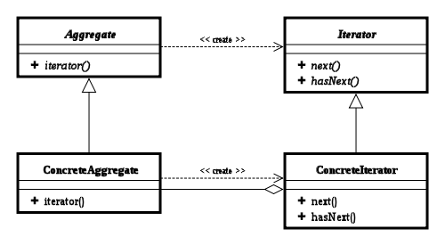
This class diagram explains the process

Slide 8
Explaining the class diagram
Iterator
Defines an interface for accessing and traversing elements.
ConcreteIterator
Implements the Iterator interface.
Keeps track of the current position in the traversal of the aggregate.
Aggregate
Defines an interface for creating an Iterator object.
ConcreteAggregate
Implements the Iterator interface to return an instance of the proper ConcreteIterator.

Slide 9
Four Methods of the Iterator
Iterator has four methods:
firstItem() resets the iterator to point to the first item in the collection.
nextItem() moves the iterator forward to next item in the collection.
isOver() returns a boolean indicating whether the collection is fully traversed or not.
getCurrentItem() returns the item to which the iterator is currently pointing.

Slide 10

Why use it?

Slide 11
Why its used?
The iterator pattern provides a way to access the elements of an aggregate object without exposing its underlying representation.
(https://www.oodesign.com/iterator-pattern.html)
Oh! what fun it is to iterate on a one-horse open java-made sleigh.

Slide 12
Why its used?
Iterator pattern is useful when you want to provide a standard way to iterate over a collection and hide the implementation logic from client program.
The logic for iteration is embedded in the collection itself.
It helps client programs to iterate over them easily.

Slide 13
Rejoice!
I have examples of how this would be implemented

Slide 14
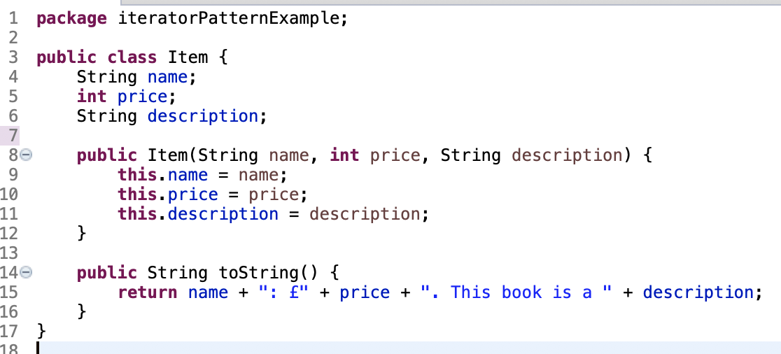
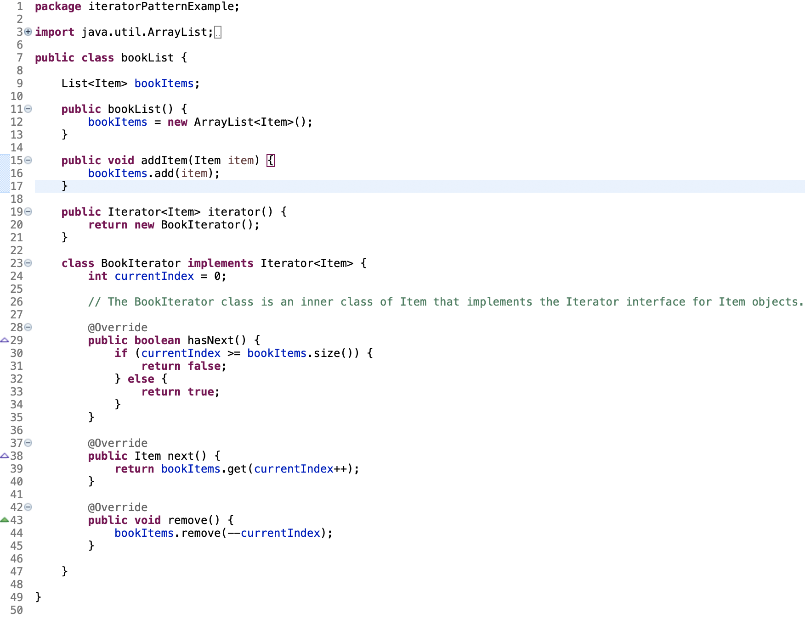
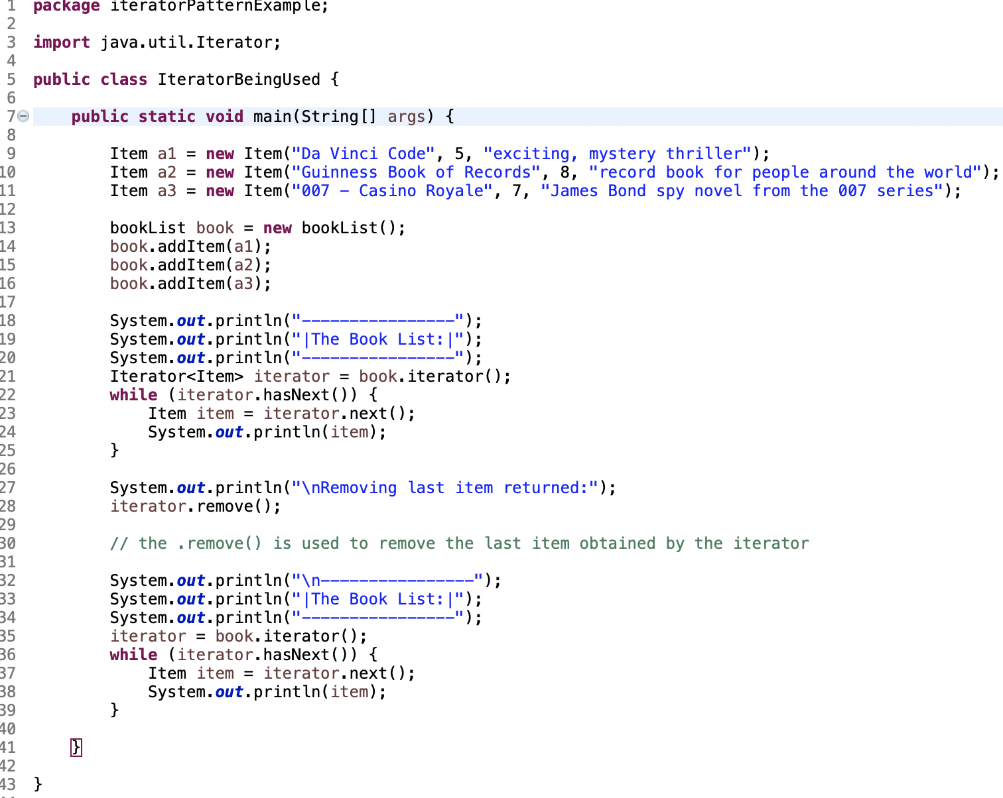

Slide 15
Code Output
----------------
|The Book List:|
----------------
Da Vinci Code: £5. This book is a exciting, mystery thriller
Guinness Book of Records: £8. This book is a record book for people around the world
007 - Casino Royale: £7. This book is a James Bond spy novel from the 007 series
Removing last item returned:
----------------
|The Book List:|
----------------
Da Vinci Code: £5. This book is a exciting, mystery thriller
Guinness Book of Records: £8. This book is a record book for people around the world

Slide 16
Explanation
The code, as you can see, is now outputted with the last entry missing.
We use the iterator.hasNext() to go to the next entry (if there is one) then use the iterator.remove() to remove it. When its re-printed, as seen on the slide before, it’s removed the last entry.
That’s because the Iterator has been implemented to iterate through the Book List to remove the last added entry using the iterator.remove() function.

Slide 17

Why Jez Hates Christmas
Jez hates Christmas due to a time when he choked on a piece of sweetcorn at his girlfriends parents house, resulting in spewing on his future mother-in-law, on their first Christmas together.
This emotional experience has made him scared to attend anything Christmas related.
He is currently undergoing therapy at the North Pole Psych Clinic to regain his love for this fantastic festive period…

Slide 18
Thankyou for listening!
Any Questions?

Slide 19
Merry Christmas
and a Happy New Year!
Find me at @thenorthpole

